Slide 1



Creative Teaching and Learning Strategies
DR. ARNEL BANAGA SALGADO, PhD (PMHN), Ph.D. (Psychology), Ed.D., Sc.D., RN, PGD
H/P No.: 050-799-3803
URL: www.ifeet.org; www.arnelsalgado.com
  Member: Sigma Theta Tau International – Honor Society of Nursing (Constituent No. 1628977)
  Member: American Psychological Association (APA Roll No. 04438162)
    Doctor of Psychology (Psy.D.)
    Fellow Program in Management (Ph.D.– Psychology)
    Doctor of Science (D.Sc.)
    Doctor of Education (Ed.D.)
    Master of Arts in Nursing (M.A.N)
    Master of Arts in Teaching - Psychology (M.A.T.)
    Registered Nurse (PH, MYL, UAE)
    Licensed Teacher (PH)
    Certificate in Teaching,
    Bachelor of Science in Nursing (BSN, PH)

Slide 2
Learning Objectives
At the end of the workshop, the students will be able to:
Promote active learning
Match student and faculty expectations
Stimulate learning in trainees

Slide 3
Outline
Course content - what needs to be covered (why? how?)
Changing landscape
Competencies (Outcomes)
Making the connection (mapping)
Some suggestions

Slide 4

Creative Teaching and Learning

Slide 5
Changing Landscape - Students
Age of incoming students decreasing (slowly)
Faculty aging
Economic and other pressures
  Value of education
  Encourage changes in careers later in life
Varied classrooms

Slide 6
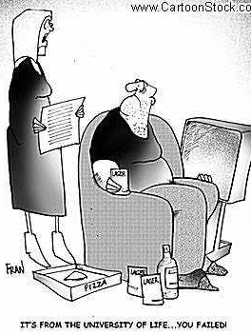
Backdrop
Life experiences impact the way people learn
Challenge for faculty to be effective in teaching and to make teaching and learning relevant

Slide 7
Generation X
“Latchkey” kids – both parents working
Many from single parent homes
Technologically savvy
Grew up with corporate downsizing and layoffs, fewer career opportunities

Slide 8

Generation X
Independent, problem solvers
Ambitious, self-starters
Want support but do not want to be told what to do or how to do it
Expect instant gratification, immediate feedback
Know they must keep learning to be marketable

Slide 9
Generation Y
Largest generation since baby boomers
Many from divorced, single parent homes but parents are extremely hands-on (“decade of the child”)
Overindulged, overprotected, self-absorbed
Technologically savvy

Slide 10

Generation Y
Self-confident, entitled
Ambitious with high expectations
Want to know process, rules, how to get ahead
Expect to start at the top
Want constant and immediate feedback
Move quickly from one thing to another
Not as independent as Gen X (parental back-up)

Slide 11
Mixed Classrooms
Older Students Younger Students
Benefits Experienced Technologically Savvy
Challenges Anxious Lack Identity
Mixed classroom closer to work environment

Slide 12

Our Students
Surfers and scanners – not readers and digesters
Expect constant and immediate feedback
Want directness over subtlety
Technologically savvy but crave personal contact
Always hurried – know what they want
Want to learn

Slide 13

Our Faculty
Healthiest and wealthiest of generations to date
Redefine traditional values
Hard-working
Passionate (can change the world)
Believe in hierarchy – may find it difficult to adapt to more flexible arrangements

Slide 14
How Faculty Spend In-Class Time
What do students retain?

Slide 15
Lecturing
Research has shown that it is impossible for students to absorb all of the information in a lecture (limited short term memory)
We need every student to learn – not just a few
More effective approach – get students actively thinking and learning

Slide 16
Student’s Expectations
Want solid knowledge base and real-world applications
Want clear and organized presentation of material
Want to be stimulated, active and participatory
Want to know why (how does this activity, reading connect to my future career?)
Want faculty to be enthusiastic, helpful and engaged
Expect “customer service”
Want face-to-face contact but accept boundaries

Slide 17
Faculty’s Challenges
Time
  Keeping up with their field
  Dealing with students with varied backgrounds and skill levels

Slide 18
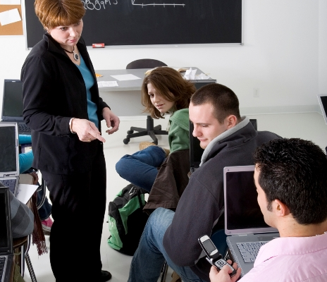
Strategies
We must understand learners
Accept differences among students and between students and faculty
Engage students in setting goals and expectations
Be flexible, creative and try not to be surprised by anything that happens in the classroom!

Slide 19
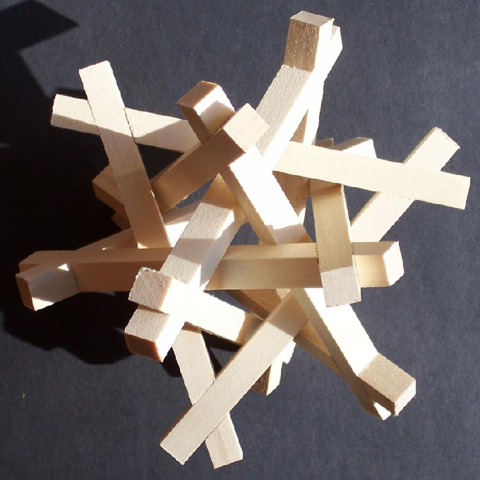
Strategies
Problem-based learning
Student-centered instruction
(Adult learning/Adult education)
Competency-based (outcomes-based) instruction

Slide 20
Student-Centered Learning
Substitute active learning projects and experiences for lectures
Hold students responsible for material not yet covered
Assign open-ended questions and problems
Use simulations, role-playing
Use self-paced or cooperative (team) learning

Slide 21
Student Challenges
Students feel that teachers have changed the rules
  Teachers not teaching
  Paying tuition for what?
Team based learning - some do not want to work in groups
  Do all members contribute equally?
  Too difficult to schedule, coordinate
  Some dominate, others hide

Slide 22
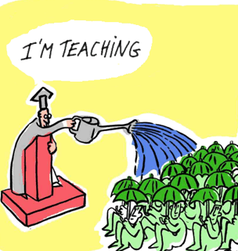
Faculty Challenges
Fear – stop lecturing & lose control
Won’t cover all of the material
Will students do the work?
Fair assessment of group and team work
Repercussions of student dissatisfaction (lower ratings, etc)

Slide 23
Competencies
Defined by the needs of the workforce and are the essential knowledge, skills and attitudes (KSA’s) required to achieve an acceptable level of performance
Achieved through formal training in the classroom and through hands-on field work (e.g., capstone experience, practicum)

Slide 24
Competencies
Each competency is supported by multiple learning objectives.
Learning objectives for the core competencies generally fall in lower-middle cognitive domains of Bloom’s Taxonomy (knowledge, comprehension, application, analysis)
Concentration-specific and cross-cutting (or interdisciplinary) objectives are more complex and include synthesis and evaluation

Slide 25
Competencies
Competencies
Learning Objectives
Learning Activities
Input from employers, alumni, faculty, staff
and students

Slide 26
Getting from Here to There….
Students
Learn best when outcomes are clear and integrated into relevant context
Need practical - not hypothetical - experiences
Competencies
Increase relevance and accountability in curricula
Challenges
Too many competencies
Levels vary
Assessment

Slide 27
Course Design
Define competencies
Map the learning objectives that support each competency
Determine activities and assessments that promote student learning that are authentic (i.e., scenarios reflecting what students would actually do in practice) and that are feasible to administer

Slide 28
Teaching Strategies
Set context
Tie topics together continually
Pre-assignments
In class lectures and activities
  Opportunity to practice – with feedback
  Audience response system “clickers”
  Short but realistic examples
Assessments

Slide 29
Be Flexible
Check-in
  Are students learning?
  How do you know?
  What could be improved?

Slide 30
Summary
Can’t satisfy everyone so mix it up!
Teach to the top
Use student-centered approaches
Use effective technology (audience response, real examples)
Consider team work, peer-to-peer exchange
Stay connected

Slide 31
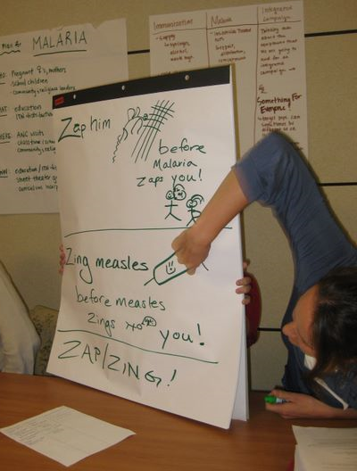
Strategies
Use different methods
  In-class
  Outside of class (must link to
  course objectives)
Encourage critical thinking and synthesis
Create opportunities for reflection
Pre-class “assignments”

Slide 32
Set The Tone
Create an environment that supports learning
Encourage different points of view
Recognize (discuss) your own biases
Maintain rigor
Excite students about content

Slide 33
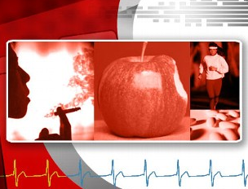
Important Questions
Make Connections
What are the causes, prevention
and treatment of autism, childhood obesity, asthma, cancer, diabetes, cardiovascular disease?
Is disease preventable with behavior change and modification of risk factors?
Are new drugs safe and effective?
How do genes affect health and longevity?

Slide 34
Discussion Points
What are your biggest challenges in teaching?
Do you have a teaching mentor?
Is teaching valued by your chair, in A&P decisions?

