Slide 1
Cholesterol and ketone body metabolism
DR. ARNEL BANAGA SALGADO, Psy.D., FMP (Psychology), Ed.D., Sc.D., RN, PGD
H/P No.: 050-799-3803
URL: www.ifeet.org; www.arnelsalgado.com
Member: Sigma Theta Tau International – Honor Society of Nursing (Constituent No. 1628977)
Member: American Psychological Association (APA Roll No. 04438162)
Doctor of Psychology (Psych.D.)
Fellow Program in Management (FPM – Psychology)
Doctor of Science (D.Sc.)
Doctor of Education (Ed.D.)
Master of Arts in Nursing (M.A.N)
Master of Arts in Teaching - Psychology (M.A.T.)
Registered Nurse (PH, MYL, UAE)
Licensed Teacher (PH)
Certificate in Teaching,
Bachelor of Science in Nursing (BSN, PH)

Slide 2
Learning Objectives
List
the Synthesis and degradation
Outline the regulation.
List various ketone bodies.
Able
to comprehend the
various
clinical
disorders

Slide 3
Cholesterol synthesis
All carbon atoms of cholesterol are derived
from acetyl CoA
Major sites are Liver, Adrenal cortex, Testis, Ovaries and Intestine
All nucleated cells can synthesize cholesterol,
including arterial walls
Enzymes
are partly located in endoplasmic
reticulum and partly in the cytoplasm

Slide 4
Cholesterol is essential to life
Various animal sources are rich in cholesterol and are called animal sterols
Nearly half each will be provided by diet and synthesis in the body
Total body content of cholesterol in a man
weighing 70kg is 140grams

Slide 5
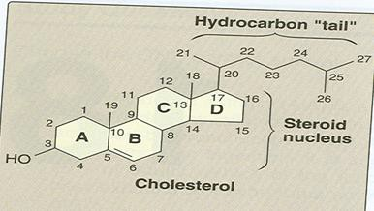
Cholesterol Structure
1. Contains atoms
27 carbon
3 cyclohexane rings fused and designated as A,B,C.
One cylopentane ring
(CPPP nucleus)
4. Hydroxyl group at position.
₃rd
5. One double
between C5 and C6
bond
An 8 carbon attached to C-17
Water insoluble
Amphoteric
chain

Slide 6
Precursors for cholesterol synthesis is Acetyl CoA
which is obtained from:
β-oxidation of Fatty acids
Oxidation of ketogenic amino acids
( Leucine and lysine)
Pyruvate dehydrogenase reaction---Acetyl CoA
B. NADPH provided by HMP shunt

Slide 7
Synthesis
Divided into 5 stages:
1. Synthesis of Mevalonate,
(6 carbon)
compound synthesized from acetyl CoA.
2. Formation of isoprenoid units,(5 carbon)
from Mevalonate.
3. 6 isoprenoid units Squalene. | combine | to | form
4. Squalene cyclizes Lanosterol. | to give | rise | to
5. Cholesterol is formed
after several steps .
from
Lanosterol

Slide 8
Step 1: Condensation
Acetyl CoA + Acetyl CoA
Acetoacetyl CoA
synthase
CoA
Acetoacetyl CoA

Slide 9
Step 2: Production of HMG CoA
Acetoacetyl CoA
HMG CoA synthase
Acetyl CoA
CoA
HMG CoA

Slide 10
HMG CoA is present in both cytosol as well as mitochondria of liver
Mitochondrial fraction ----- Ketogenesis
Cytosol fraction----- Cholesterol synthesis

Slide 11
Step 3
HMG CoA
HMG CoA reductase
2NADPH+ + 2H+
2NADP+
Mevalonate

Slide 12
HMG
CoA reductase
is an microsomal
enzyme
Rate limiting step of cholesterol synthesis

Slide 13
Mevalonate is successively phosphorylated to
phospho-mevalonate
3-phospho 5-pyrophosphomevalonate

Slide 14
Mevalonate
phosphorylation
undergoes
3
(ATP) reactions to
form 3 phospho
5 pyro phosphate
mevalanate.
This
form 5C
undergoes
decarboxylation to
unit
molecule an isoprene
Isopentenyl pyrophosphate (IPP).

Slide 15
A series of reactions occurs to form squalene (30C)
5C+5C—10C, +5C----15C,
+15C---- 30C
This
undergoes oxidation using molecular
oxygen and NADPH – converts to lanosterol
Squalene cyclizes to form 30C lanosterol
Conversion of lanosterol to cholesterol is an multistep process resulting in shortening of carbon chain and migration of double bonds.

Slide 17
Regulation
Regulation
at transcription---
Depends on
cholesterol levels in the blood
Covalent
modification– cAMP mediated
cascade phosphorylated--- Inactive
Insulin and thyroxine – Increases cholesterol
synthesis
Drugs–
inhibit the enzyme and decreases
cholesterol levels---- Lovastatin

Slide 19
Degradation of cholesterol
Normal total cholesterol level—140-200mg/dl
Incorporated into cell membranes
Steroid hormone synthesis
Esterified with saturated fatty acids and stored in cells ---Acyl Cholesterol Acyl Transferase (ACAT)
Esterified with PUFA --- Lecithine Cholesterol
Acyl Transferase (LACT)
Finally excreted by liver

Slide 21
Synthesis
of bile acids is one of the
predominant mechanisms for the excretion
Takes place in liver.
Cholesterol
is converted to 7α-hydroxy
cholesterol the reaction catalyzed by the 7α- hydroxylase is the rate limiting step in bile acid synthesis.
The most abundant bile acids in human bile are cholic acid (60%) and chenodeoxycholic acid (40%).
These are referred to as the primary bile acid

Slide 22
Within the intestines the primary bile
acids undergo de-conjugation and dehydration by bacteria and converted to secondary bile acids, deoxycholic acid (from cholic acid) and lithocholic acid (from chenodeoxycholic acid).

Slide 23
Both primary and secondary bile acids are reabsorbed by the intestines and delivered back to the liver via the portal circulation this is enterohepatic circulation.
In the bile the conjugated bile acids exist as sodium or potassium salts known as bile salts.

Slide 24
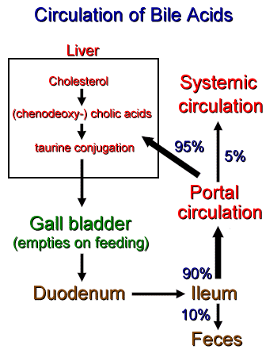

Slide 25
Importance of bile acids
Only way for the excretion of cholesterol
Helps in absorption of lipids by acting as
emulsifying agent
Helps in absorption of fat soluble vitamins
Prevents precipitation of cholesterol

Slide 26
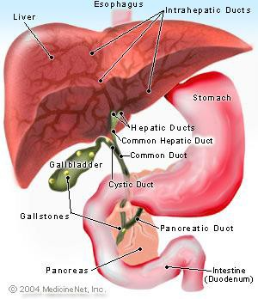
Gall stones

Slide 27
Mechanism of action: Hypolipidemic drugs
Bile
acid binding resins--- Cholestyramine
decrease the reabsorption of bile acids
HMG CoA reductase inhibitors– Atarvostatin and Simvostatin
Nicotinic
acid—Inhibits lipolysis so VLDL
levels decreased
Vitamin E– minimizes oxidation of LDL
Fibrates---
Lower TAG levels by activating
lipoprotein lipase

Slide 28
Increased cholesterol levels
Diabetes mellitus
Obstructive jaundice
Hypothyroidism
Nephrotic syndrome
Familial hyperlipoproteinemias
Atherosclerosis

Slide 29
Hypocholesterolemia
Decrease in plasma cholesterol less than
70mg/dl.
Causes:
Hyperthyroidism.
Malnutrition.
Malabsorption.
Hemolytic Jaundice.

Slide 30
Ketone body

Slide 31
Introduction
During
high rates of fatty acid oxidation,
primarily in the liver, large amounts of acetyl- CoA are generated.
These exceed the capacity of the TCA cycle, and result in the synthesis of Ketone bodies, the process is called ketogenesis.
The Ketone bodies are acetoacetate (Primary KB), β-hydroxy butyrate, and acetone (Secondary KB).

Slide 32
Ketone bodies are water-soluble compounds.
They are used as a source of energy in the peripheral tissues.
In the brain, they are a vital source of energy during fasting.
Normal levels in plasma and urine are less
than 1mg/dl.

Slide 33
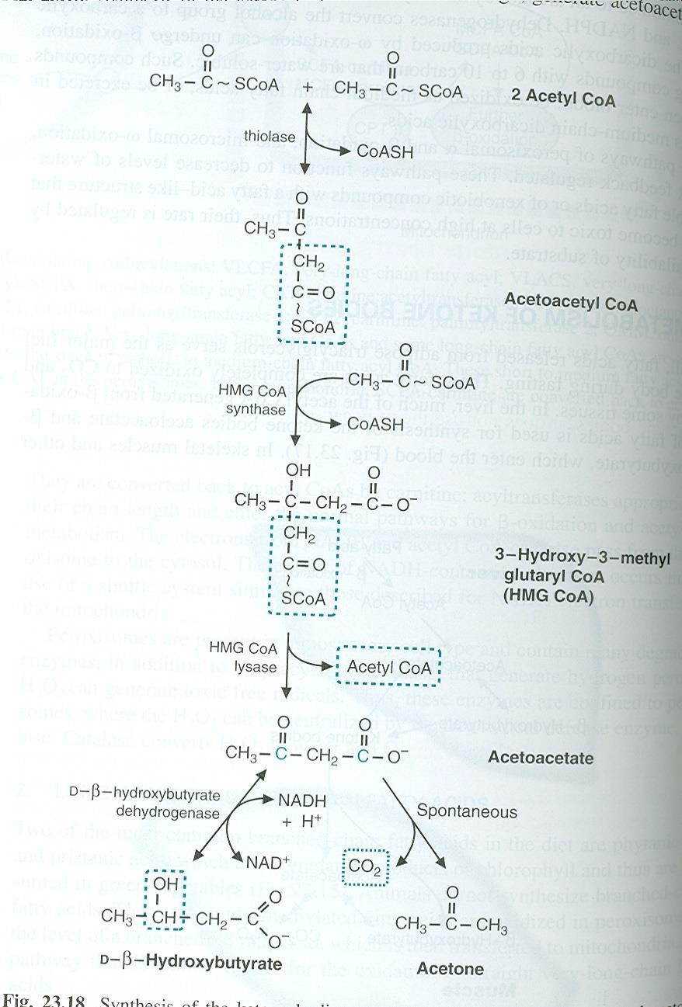
KB are
synthesized
Synthesis
exclusively
mitochondria.
in Liver
Acetyl CoA starting material
is the
by oxidation
obtained
of :
Pyruvate
Fatty acids
Ketogenic amino acids
(lysine, phenylalanine, tyrosine)
Leucine,
HMG CoA synthase is rate limiting.

Slide 34
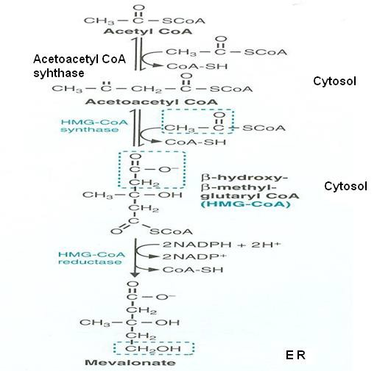
Comparison of cholesterol and ketone body Metabolism
Cholesterol Metabolism
ketone body Metabolism

Slide 35
Utilization
The two main Ketone bodies, acetoacetate and Beta hydroxy butyrate are water soluble, they are readily transported from the liver to various peripheral tissues like
skeletal,
cardiac muscle,
renal cortex,
intestinal mucosa and
brain which use them as important sources of energy.
Tissues that lack mitochondria cannot metabolize Ketone bodies.

Slide 36
Utilization
Ketone bodies are the major fuel during
fasting.
The first step involves the reversal of the β- hydroxy butyrate Dehydrogenase reaction.

Slide 37
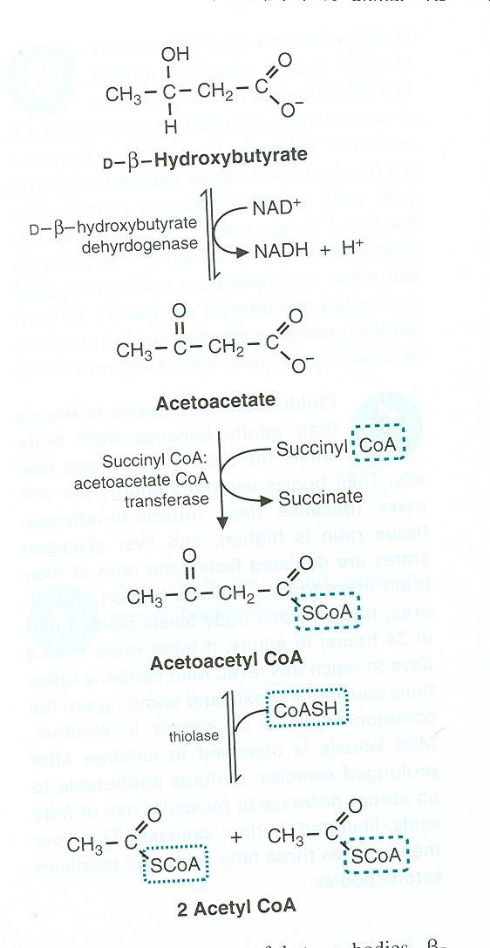
Utilization
Liver cannot
utilize
Ketone bodies for it lacks enzyme acetoacetate : succinyl-CoA transferase (Thiophorase.)

Slide 38
Excessive production of KB
Normally rate of KB synthesis and oxidation are balanced so that their serum concentration is maintained around 1mg/dl and urinary excretion is negligible 1mg/24hrs.
However when rate of ketogenesis exceeds their utilization, their condition in the blood rises, and the condition is known as:
Ketonemia: accumulation of Ketone bodies in the
blood.
Ketonuria: excretion in urine
Ketosis: Ketonemia and Ketonuria

Slide 39
Regulation
The
increased ratio of
Glucagon/insulin
promotes Ketone body formation.
Glucagon
inhibits
glycolysis, lipolysis,
stimulates decreases
Gluconeogenesis and
malonyl CoA and stimulate beta oxidation and
ketogenesis.
whereas insulin as opposite effect.

Slide 40
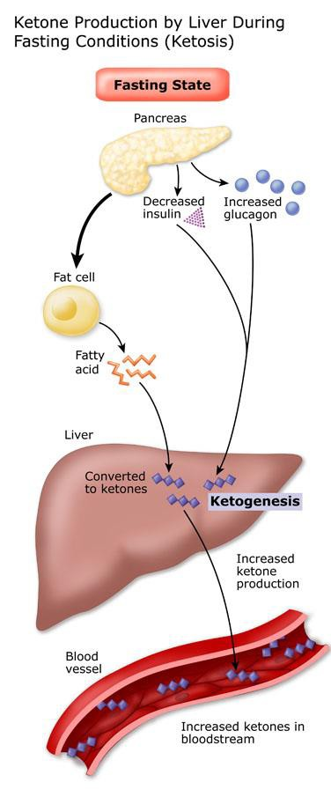

Slide 41
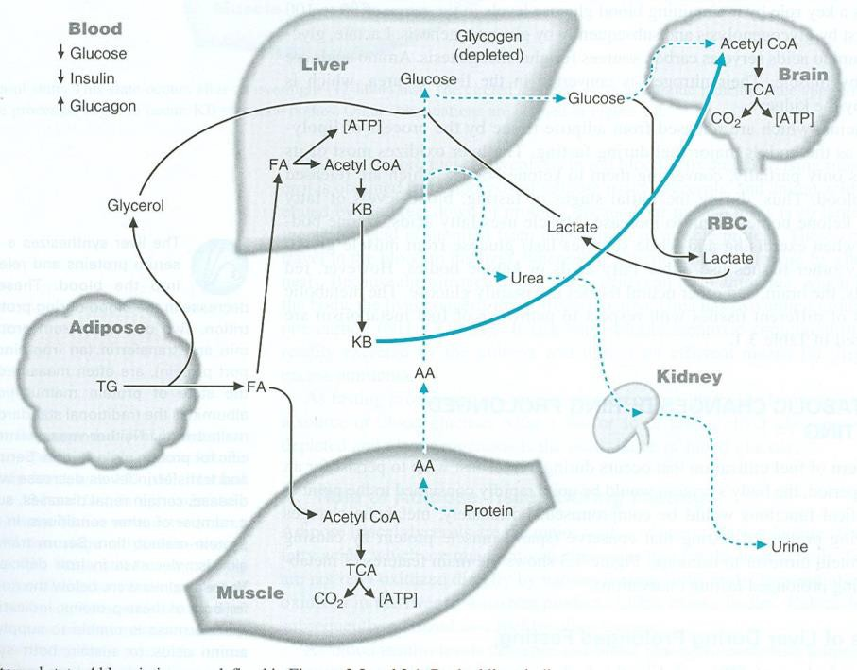
Metabolic changes during Prolonged fasting

Slide 42
Causes:
For the increased ratio of Glucagon/insulin:
Starvation
Hyper emesis
Consumption of high fat diet.
Diabetes Mellitus

Slide 43
Consequences of Ketosis
Metabolic acidosis
Reduced Buffers
Kussmaul’s breathing
Smell of acetone
Osmotic diuresis
Dehydration
Loss of cations
Coma

Slide 44
Explanation (DKA)
Ketone bodies are relatively strong acids (pKa around 3.5), and their increase lowers the pH of the blood. This acidification of the blood is dangerous chiefly because it impairs the ability of hemoglobin to bind oxygen.

Slide 45
Diabetic Ketoacidosis (DKA)
In diabetes hyperglycemia and glycosuria produce
osmotic diuresis resulting in dehydration.
Non volatile KB are excreted as their sodium and
potassium salts in urine.
Bicarbonate is required to buffer the acidic KB poured into the circulation as a result bicarbonate is decreased resulting in metabolic acidosis.
Kussmaul breathing due to hyperventilation volatile
KB is exhaled out through lungs.

Slide 46
Diagnosis
Rothera’s test: presence of KB in urine
Supportive
evidence : serum electrolytes,
ABG, glucose estimations.

Slide 47
MCQ,s

Slide 48
Lovastatin is a
Competitive inhibitor of acetyl CoA
carboxylase
Competitive inhibitor of HMG CoA synthetase
Non-competitive inhibitor of HMG CoA
reductase
Competitive inhibitor of HMG CoA reductase

Slide 49
Hypocholesterolaemia can occur in
Hyperthyroidism
Nephrotic syndrome
Obstructive jaundice
Diabetes mellitus

Slide 50
References and acknowledgments
Text book of Biochemistry- Lippincott’s 5th
Edition
Text book of Biochemistry for Dental
students 2nd
edition By DM Vasudevan
www.google.com/google images

