Slide 1
Theoretical Foundation of Ethics and Decision Making in Nursing Dr. Arnel Banaga Salgado

Slide 2
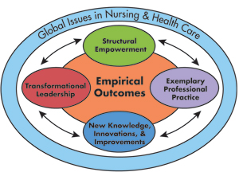
Basic ethical concepts The standard of best interest
Applied when a decision must be made about a patient’s health care and the patient is unable to make an informed decision

Slide 3
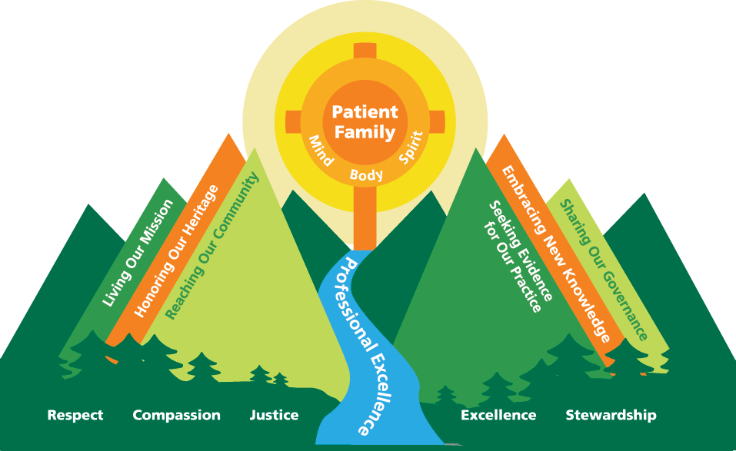
Ethical theory
An ethical theory provides a framework within which agents can reflect on the acceptability of actions and can evaluate moral judgments and moral character

Slide 4
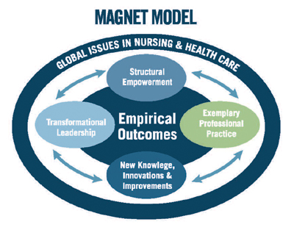
Ethical theories
1- Teleology
2- Deontology
3- Institutionism
4- Ethic of caring

Slide 5
Ethical theories
Teleology: looks to the consequences of an action in judging whether that action is right or wrong
Deontology: proposes that the mortality of a decision is not determined by its consequences. It emphasizes duty, rationality, and obedience to rules
The difference between Teleology and Deontology can be seen when each approach is applied to the issue of abortion

Slide 6
Example:
Teleology approach/abortion: saving the mother’s life (the end, or consequence) justifies the abortion (the mean, or act)
Deontology approach/abortion: consider any termination of life as a violation of the rule “do not kill” and therefore, would not abort the fetus, regardless of the consequences to the mother

Slide 7
Institutionism: summarized as the notion that people inherently know what is right or wrong; determining what is right is not a matter or rational thought or learning (e.g. the nurse inherently knows it is wrong to strike a client, the nurse does not need to be taught this or to reason it out)
The preceding three theories are based on the concept of fairness (justice)
Ethic of caring: it is based on relationships.
Caring is a force for protecting and enhancing client dignity
Caring is of central importance in the client-nurse relationship (e.g. nurses use trust-telling to affirm clients as a persons rather than objects and to assist them to make choices and find meaning in their illness experiences)

Slide 8
Guidelines for Ethical Reasoning
Stay open-minded. Challenge your own views. It’s not enough just to hold a position, you must be able to support it with good reasons.
Challenge the views of others if you disagree with them, but do so respectfully and considerately.
Philosophical discussion loses most of its value if it’s used as a place to dominate or show off.
Philosophical discussion is best done as a community enterprise, where all the discussants work together to get closer to the truth.

Slide 9
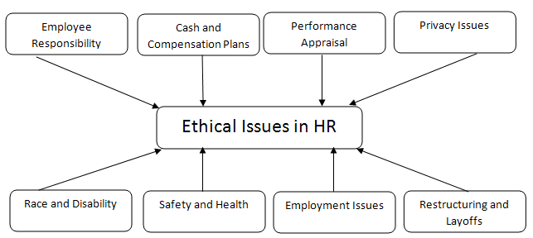
Nursing Codes of Ethics
A code of ethics is a formal statement of a group’s ideals and values.
It is a set of ethical principles that is shared by members of the group, reflects their moral judgments over time and serves as a standard for their professional actions.
Codes of Ethics are usually higher than legal standards
International, national, state nursing associations have established codes of ethics

Slide 10
Nursing Codes of Ethics (purposes)
To inform the public about the minimum standards of the profession and to help them understand professional nursing conducts
To provide a sign of the profession’s commitment to the public it serves
To outline the major ethical considerations of the profession
To provide general guidelines for professional behavior
To guide the profession in self-regulation
To remind nurses of the special responsibility they assume when caring for clients.

Slide 11
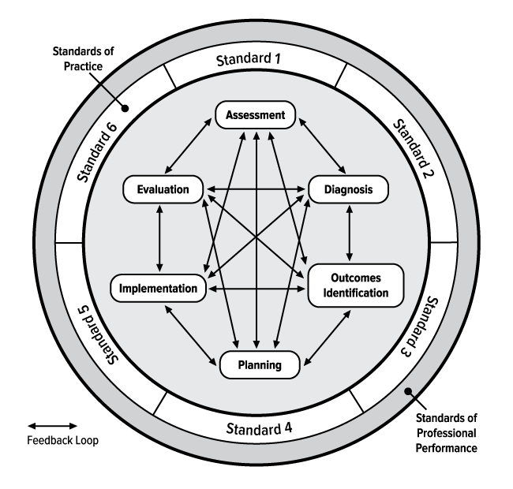
Nursing Codes of Ethics (elements)
Nurses have four fundamental responsibilities: to promote health, to prevent illness, to restore health, and alleviate suffering.
Nurses and people
Nurses and practice
Nurses and the profession
Nurses and the co-workers

Slide 12
What is Ethical Decision Making?
When faced with an ethical dilemma the objective is to make a judgment based on well-reasoned, defensible ethical principles.
The risk is poor judgment i.e. a low-quality decision
A low-quality decision can have a wide range of negative consequences

Slide 13
Two Types of Ethical Choices
Right vs wrong: choosing right from wrong is the easiest
Right vs right
Situation contains shades of gray i.e. all alternative have desirable and undesirable results
Choosing “the lesser of two evils”
Objective: make a defensible decision

Slide 14
Factors that influence EDM
Codes for Nurses
The patient’s rights
Social and cultural attitudes
Science and technology
Legislation
Judicial decisions
Funding
Personal religious and philosophic viewpoint

Slide 15
Factors in the work environment that affect EDM
Status as an employment
Collective bargaining contracts
Collegial relationships
Authoritarian and paternalistic background
Ethics committees in health care
Consumer involvement in health care

Slide 16
A framework for Ethical Decision Making (EDM)
Identify and clarify the ethical problem
Gather data
Identify options
Make a decision
Act and assess

Slide 17
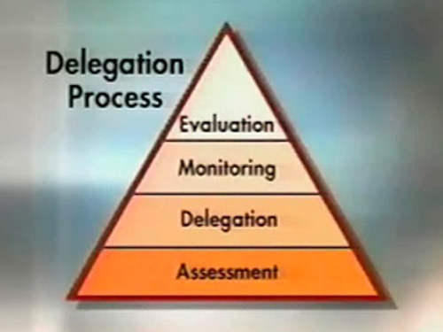
Making Moral Decisions--Some Inappropriate Ways:
Appeal to Authority
Appeal to Law
Appeal exclusively to self-interest

Slide 18
Some Guidelines for Making Ethical Decisions
1. Choose correct moral language.(Often, the way in which you initially
conceptualize a situation will affect
what moral conclusions you will make)
2. Be as clear as you can about the facts, both empirical and philosophical
3. Consider the relevant moral principles and rules, and make your best judgment.

Slide 19
Ethics Committees
With the increasing complexity of ethical issues in health care, ethics committees have been created to assist in making ethical decisions in clinical settings. Ethical committees can:
1. Provide structure and guidelines for potential problems.
2. Serve as an open forum for discussion and debate.
3. Function as a patient advocate by placing the patient at the core of the committee’s deliberations.

Slide 20
Ethics Committees
With the increasing complexity of ethical issues in health care, ethics committees have been created to assist in making ethical decisions in clinical settings. Ethical committees can:
1. Provide structure and guidelines for potential problems.
2. Serve as an open forum for discussion and debate.
3. Function as a patient advocate by placing the patient at the core of the committee’s deliberations.

Slide 21
Discussion Questions
Is the patient’s decision a rational one?
What is the difference between withholding and withdrawing life-sustaining treatment?
In view of the fact that a potent sedative such as morphine may produce respiratory depression, should this be given prior to discontinuing the respirator? Would this constitute active euthanasia?
Would the situation be different if Mrs. C. had a living will?
What role could the nurse play in addressing the ethical issues in this case?

Slide 22
notes
Euthanasia
Greek words meaning “easy death”.
Euthanasia is an act by which the causative agent of death is administered by another with the intent to end life.
Killing an innocent person, even at his or her request is not ethical.
“Code for Nurses (1985) and the ANA position statement (1994) states that the nurse should not participate in euthanasia but be vigilant advocates for the delivery of dignified and human care.

Slide 23
Living Wills
Prepared while patient has decisional capacity
Describes patient preferences in the event they become incapable of making decisions or communicating decisions.
Usually describes what type of life prolonging procedures the patient would or would not want and circumstances under which they would want these procedures carried out, withheld, or withdrawn

