Slide 1
Nursing Law & Liability
Dr. Arnel Banaga Salgado

Slide 2
Topics for discussion
Sources of Law
Divisions of Law
Good Samaritan Act
Issues in Health-Care Litigation
Preventing Lawsuits

Slide 3
Sources of Law
Statutory Law:
written and enacted by congress, state legislatures & other government entities
laws that govern the profession of nursing are mostly written at the state level, because licensure is a state issue
include the Nurse Practice Act that enables the state boards of nursing, individual licensure procedures and schedule of fees for the state

Slide 4
Sources of Law
Common Law:
evolved from decisions of previous legal cases that form a precedent (to precede = to come before)
Include laws involving negligence or malpractice for nurses

Slide 5
Divisions of Law
Civil Law:
violation of one individual’s rights by another individual
tort law: branch involving most nurses
tort: wrongful act committed against a person or his/ her property independent of a contract

Slide 6
Divisions of Law
Criminal Law:
concerned with providing protection for all members of society
punishment is to fit the crime
Nurses : failing to renew license
: illegal diversion of drugs
: assisted suicide
: intentional / unintentional deaths

Slide 7
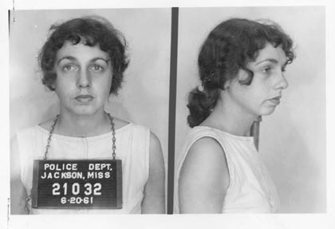
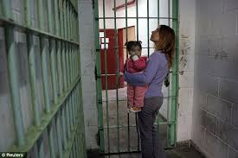
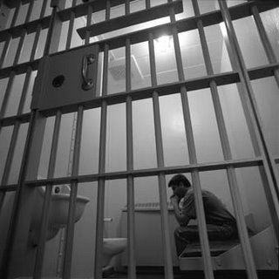

Slide 8
Unintentional Tort
Negligence: omission of something a reasonable and prudent person would do in a similar situation
(“Prudence, be reasonable!”)
or
commission of something a reasonable person would not do in a similar situation
(“What were you thinking?”)
Malpractice is the type of negligence for which professionals can be sued. It indicates professional misconduct or unreasonable lack of skill in performing professional duties.

Slide 9
Intentional Tort
A willful act that violates another’s rights or property. Has three requirements:
The person intended to bring about the consequences,
Intended to interfere with someone’s property
Was a substantial factor in bringing about the injury or consequence

Slide 10
Intentional Tort
Assault - unjustifiable attempt to touch another or the threat of doing so
Battery- harmful or unwarranted contact with another without consent
False Imprisonment - a competent pt is confined/ restrained with the intent of preventing him from leaving the hospital (or use of threats or medications that interfere with ability to leave the facility)
Abandonment of clients - breach of contract, can cause injury
Intentional infliction of emotional distress

Slide 11
Quasi-Intentional Tort
Mix of unintentional and intentional
A voluntary act that causes injury or distress without intent to injure or cause distress
A usually involve situations of communication with violate a person’s reputation, personal privacy or civil rights

Slide 12
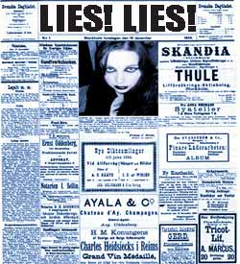
Defamation of Character
*libel - written
*Slander - spoken

Slide 13
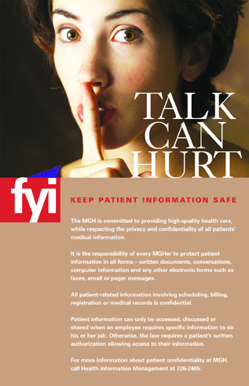
Invasion of Privacy -
violation of right to protect against unreasonable & unwarranted interference with one’s personal life
Breach of Confidentiality -
trust and confidence are violated by public revelation of confidential communication without client consent

Slide 14
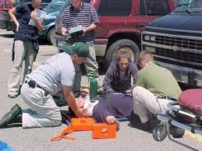
Good Samaritan
Good Samaritan Act
protects healthcare
providers in emergency
situations within the
scope of their
professional education!
what if you had to perform a tracheostomy? What would Prudence B. Reasonable do?

Slide 15
Dispute Fora:
Lawsuits
Mediation - trying to find common ground
Arbitration - neutral third party makes the decision

Slide 16
Issues in Health - Care Litigation
Informed consent - person performing the procedure is the one to get the consent. Informed means informed!
Patient Self-Determination Act - all federally-funded institutions must inform clients of their right to prepare advanced directives (living will, medical durable power of attorney)
DNR orders- needs a written order in the medical record

Slide 17
Sample Nursing Laws of Each Country
UAE - UAE Ministers' Cabinet Resolution 10, 2009
Malaysia - Act-14-06042017
Philippines - Republic Act No. 9173
India - ACT NO. 48 OF 19471
Additional Reading - Nurse Practice Acts Guide and Govern: Update 2017

Slide 18
Issues in Health-Care Litigation
Standards of Care- what would a reasonable and prudent nurse do in the same situation
The Nurse Practice Act - defines nursing and sets standards in each state
-defines scope of practice, license requirements, IDs grounds for disciplinary actions, oversees the practice of nursing

Slide 19
Ways to Prevent Lawsuits
Medical documentation - complete, accurate, legible (thanks computers), no opinions, in chronological order, signed
Establish rapport with clients
Keep current on your nursing skills
Have some knowledge of the client
(be direct, problem-solving with the client, have client involved in own care, careful documentation if client is lawsuit prone)

Slide 20
And don’t forget to get professional liability insurance!

